Slide 1

Smiles for miles Network Infrastructure Proposal
By: Jacob Simpson

Slide 2
Scenario Recap
First, let's recap the scenario. Smiles for Miles is venturing into Hell, Michigan, with a mission to provide dental services. Our objective is to design a robust network infrastructure to support their operations

Slide 3
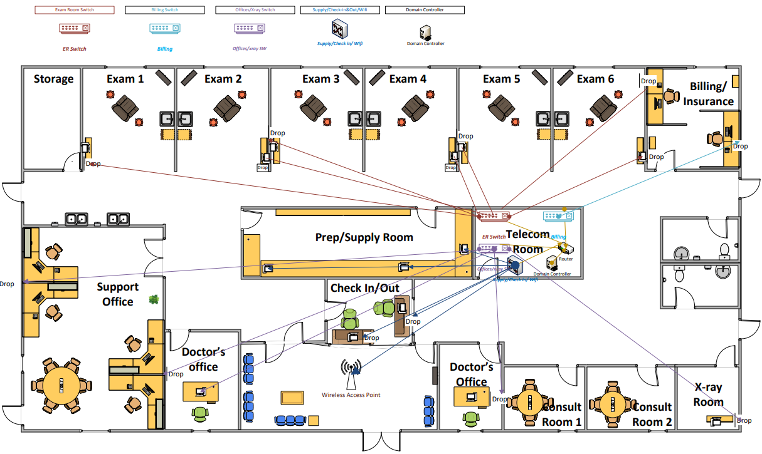
Wiring Diagram
As you can see in the wiring diagram, we've carefully planned the layout to ensure efficient connectivity for all devices. Each connection for the switches will be color-coded, providing clear visual guidance for installation and maintenance.
Each computer will have internet access, and the reception desk printer will be seamlessly integrated into the network for printing customer receipts.

Slide 4
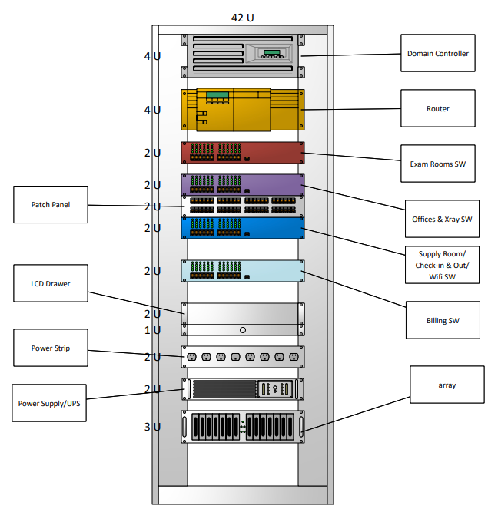
Equipment Diagram
In the equipment rack, we've selected high-quality routers, switches, and other networking devices to ensure reliability and scalability. The diagram illustrates the layout of all equipment to ensure optimal organization and accessibility for maintenance purposes

Slide 5
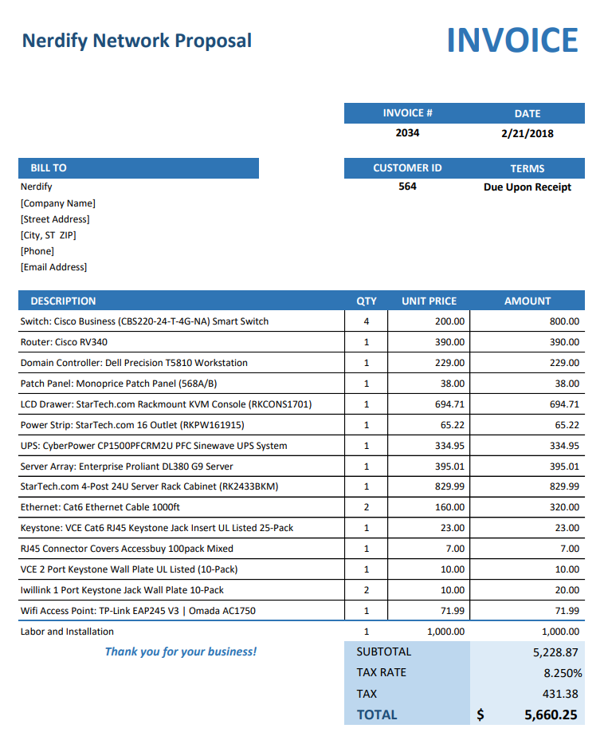
Bill of Materials
Our bill of materials outlines all necessary components, ensuring transparency in costs and specifications. including routers, switches, cables, and accessories. The total cost for the proposed network infrastructure is $5,660.25. This includes the cost of equipment, installation, and any additional services required.
We believe this investment is essential for Smiles for Miles to effectively manage operations and provide quality service for patients. Our proposal aims to provide a reliable and scalable network infrastructure that meets the current needs and can accommodate future growth.

Slide 6

Conclusion
In conclusion, our proposed network infrastructure plan will provide Smiles for Miles with a solid foundation for operations in Hell, Michigan. Thank you for considering our proposal. We look forward to the opportunity to work together!!!

Slide 7
THANK YOU
For further inquiries or to discuss this proposal in more detail, please contact us at 512.255.1320 or email us at NerdifyEnterprises@Nerdify.com

